Slide 1
DEVELOPER – INTRODUCTION TO AGILE

Slide 2
AGENDA
The Agile Narrative
Agile Manifesto, Principles and Values
Comparing Waterfall with Agile
Advantages and Challenges of Agile
Lean Overview

Slide 3
THE AGILE NARRATIVE
Agile software development is a group of software development methods based on:
Iterative and Incremental Development where requirements and solutions evolve through collaboration between self-organizing, cross-functional teams.
Adaptive Planning evolutionary development and delivery, and encourages rapid and flexible response to change.
Direct Collaboration and Communication between business and development organizations.
Interactions throughout the development cycle.

Slide 4
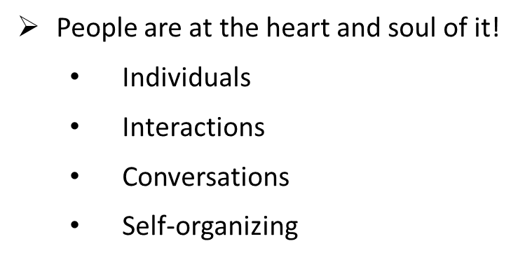
THE AGILE MANIFESTO Individuals and Interactions Over Processes and Tools

Slide 5
PRODUCT OVER DOCUMENTATION Working Software over Extensive and Comprehensive Documentation
Not one instead of the other!
Produce only as much documentation as is needed right now to produce a working product.

Slide 6
EMBRACE CHANGE OVER STAYING TO “THE PLAN” Responding to Change over Following a Plan
“Planning is indispensable, but is worthless come execution time”.
As the project unfolds, changes will be seen that are needed “immediately”, or in an upcoming Sprint.
Embrace change

Slide 7
CUSTOMERS OVER CONTRACTS
Customer Collaboration
over
Contract Negotiation
Because all requirements cannot be known at the beginning of a project, Agile stresses the need for continuous engagement and conversation with the business during the course of the project.
Business and IT no longer sign a contract and walk their separate ways.

Slide 8
AGILE MANIFESTO’S TENETS – SOME TAKEAWAYS
Communication is generally considered to be the most important critical success factor for any project (Agile or waterfall).
Processes seem logical, but they often get in the way and slow down product development – and its rollout into production.
Agile teams create “just in time” and “just enough” documentation.
Agile teams embrace change to the backlog of work.

Slide 9
AGILE MANIFESTO’S TENETS – SOME TAKEAWAYS
Communication is generally considered to be the most important critical success factor for any project (Agile or waterfall).
Processes seem logical, but they often get in the way and slow down product development – and its rollout into production.
Agile teams create “just in time” and “just enough” documentation.
Agile teams embrace change to the backlog of work.

Slide 10
THE MANIFESTO’S 12 PRINCIPLES
1. Customer satisfaction by rapid delivery of useful software
2. Welcoming changing requirements, even late in development
3. Working software is delivered frequently (in only days or weeks)
4. Close, daily cooperation between business people and developers
5. Projects are built around motivated individuals who should be trusted
6. Face-to-face conversation is the best form of communication
7. Working software is the principal measure of progress
8. Sustainable development, ability for a delivery team to maintain a constant pace
indefinitely
9. Continuous attention to technical excellence and good design
10. Simplicity – the art of maximizing the amount of work not done – is essential
11. Self-organizing teams
12. Regular adaptation to changing circumstances

Slide 11
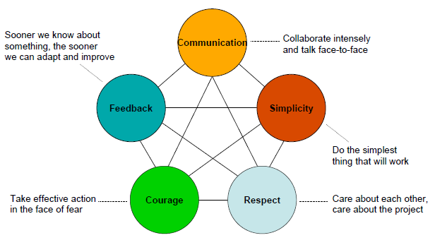
AGILE VALUES

Slide 12
SCRUM AND XP VALUES
Values è The foundation for all the activities and artifacts for a project following an Agile. As a team improves to make themselves more efficient, the values act as a benchmark.
Scrum Values
Transparency – all work is performed in a transparent manner
Inspection – review the team’s performance and their process at cadence checkpoints
Adaptation – make adjustments to improve team performance or streamline the process
XP Values
Trust between team members, between the team and the business, between the team and management
Simplicity – focus on the simplest design first and iterate to increase complexity
Feedback – seek out feedback from stakeholders and end users frequently.

Slide 13
ADVANTAGES OF AGILE
Seek stakeholder’s approval regularly.
Releasable software at the end of each iteration.
Testing during the whole development cycle.
Short iterations are easy to plan.
The power of team.

Slide 14
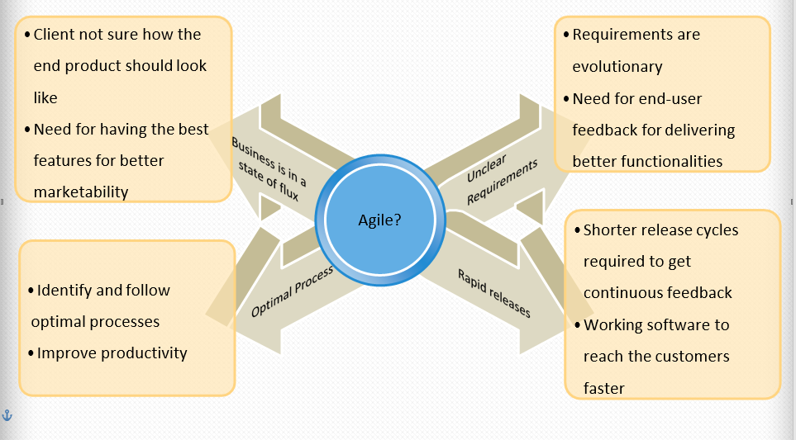
WHEN TO CONSIDER AGILE..

Slide 15
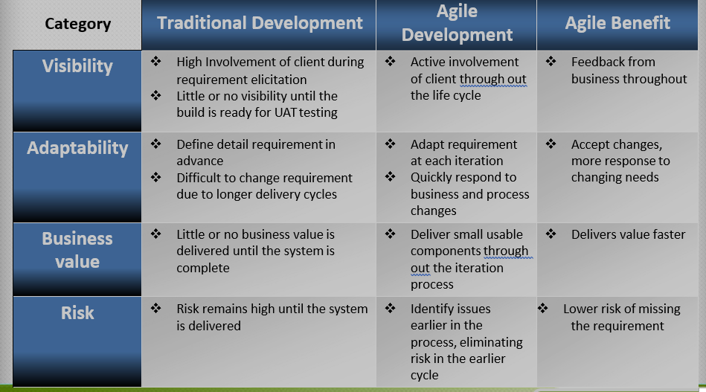
COMPARING AGILE AND TRADITIONAL METHODOLOGIES

Slide 16
AGILE VS. WATERFALL: THE TAKEAWAYS
Whether the model is waterfall or Agile, communication is generally considered to be the most important critical success factor for any project.
Processes seem logical, but they often get in the way and slow down product development – and rollout into production.
Agile Teams create “Just In Time” documentation.
Agile embraces change; waterfall resists it.

Slide 17
LEAN OVERVIEW
Lean is the foundation of Agile.
Lean is a way of thinking.
Lean means creating more value for customers with fewer resources and minimized waste.

Slide 18
LEAN PRINCIPLES
Eliminate waste
"There is nothing so useless as doing efficiently that which should not be
done at all." – Peter Drucker
Reduce work in progress
Add value
80/20 rule – 80% value in 20% of the scope/work
Quality is built-in/non-negotiable
No tolerance for defects – especially at the end
Shift quality to the left – move as close to source as practical
Fix the process to eliminate the defects

Slide 19
LEAN PRINCIPLES
Create knowledge
Disciplined approach to problem solving
Continuous Improvement/Kaizen
Best Practices are history lessons - solutions to past problems
Defer commitment
“In preparing for battle I have always found that plans are useless, but
planning is indispensable” - General Dwight Eisenhower
Planning is not commitment
Defer commitment to last practical moment

Slide 20
Agenda
Scrum Framework
Scrum Roles and Responsibilities
Product Owner
Scrum Master
Scrum Team
Scrum Challenges

Slide 22
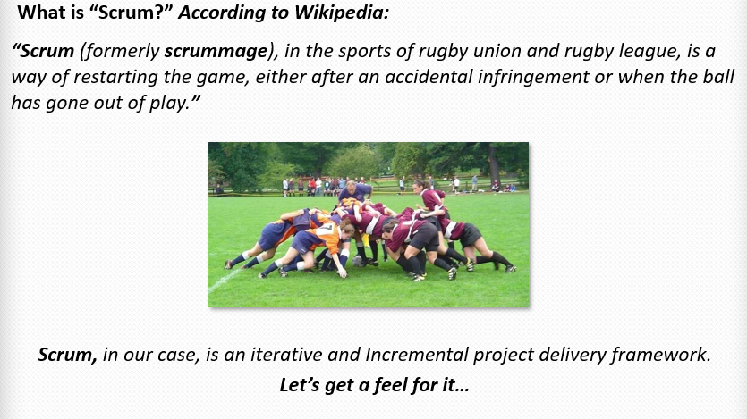
Scrum Process Overview

Slide 23
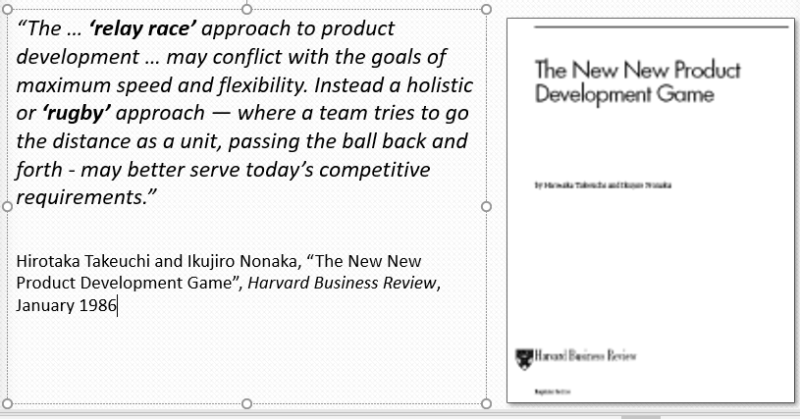
Origin of Scrum

Slide 24
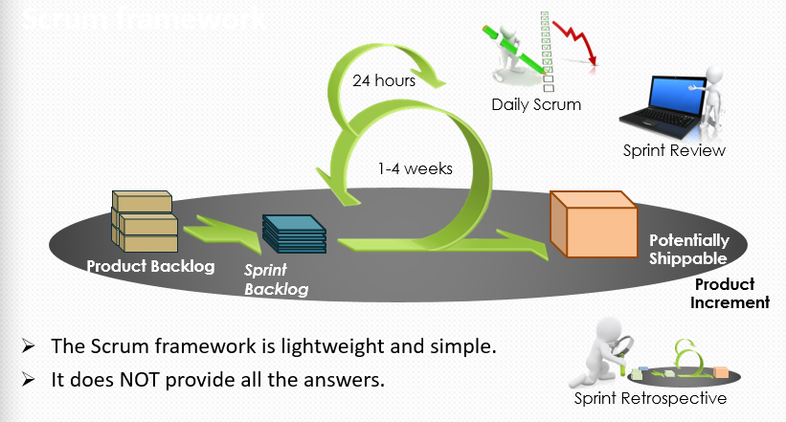
The Scrum Framework

Slide 25
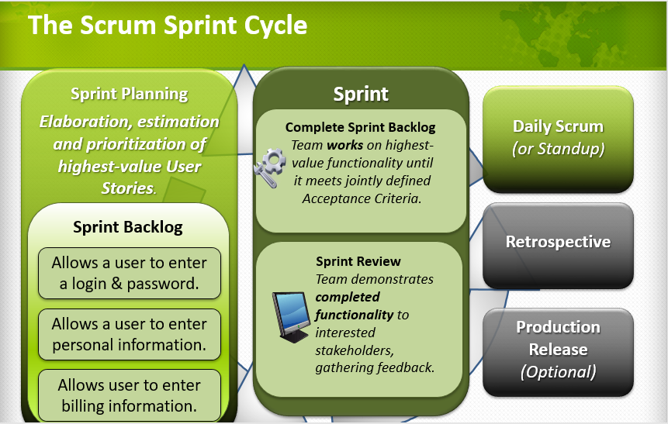

Slide 26
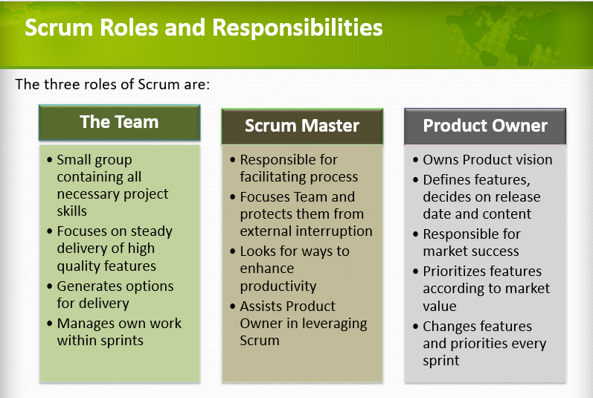

Slide 27
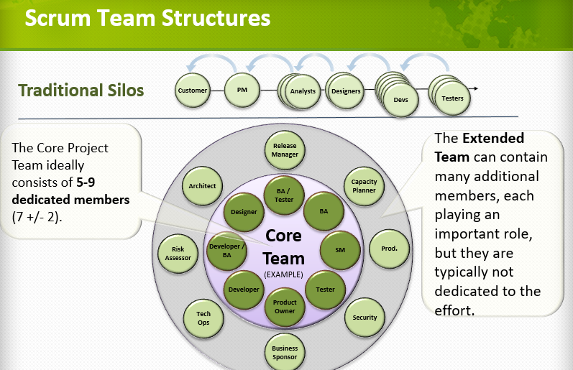

Slide 28
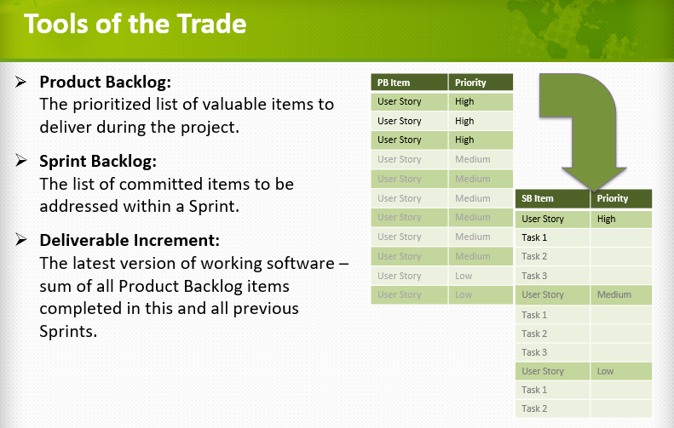

Slide 29
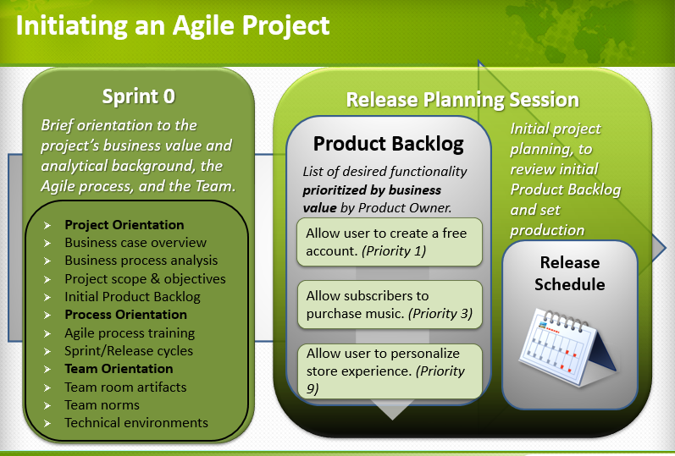

Slide 30
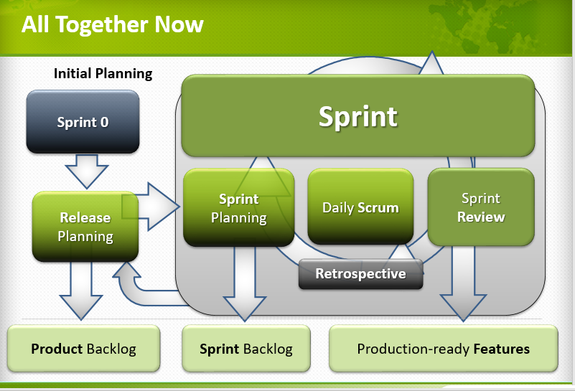

Slide 31
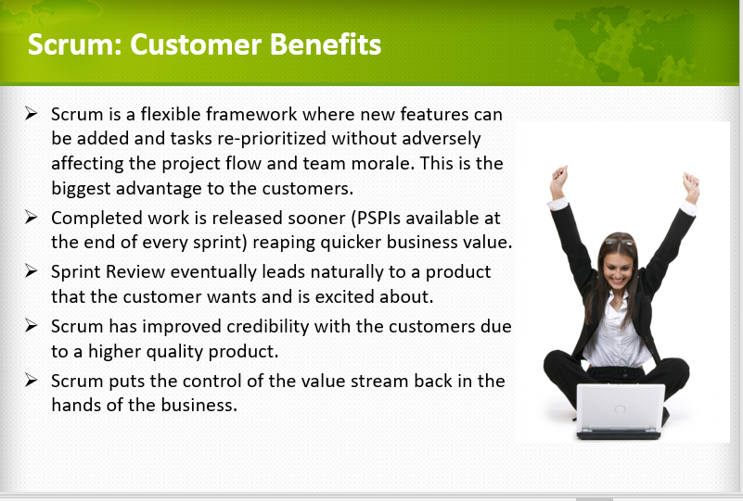

Slide 32
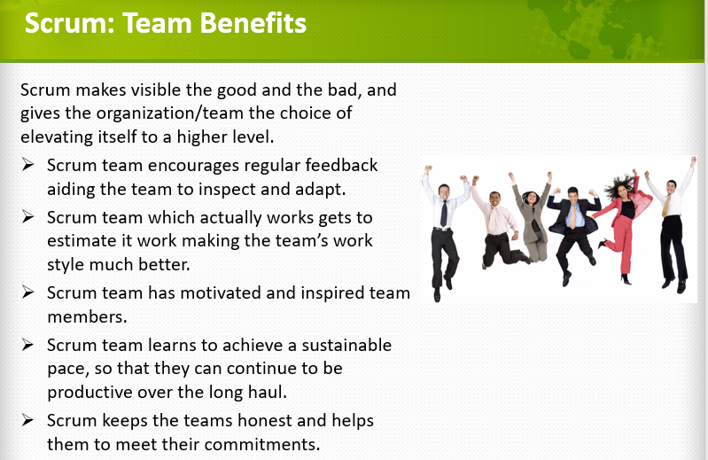

Slide 33
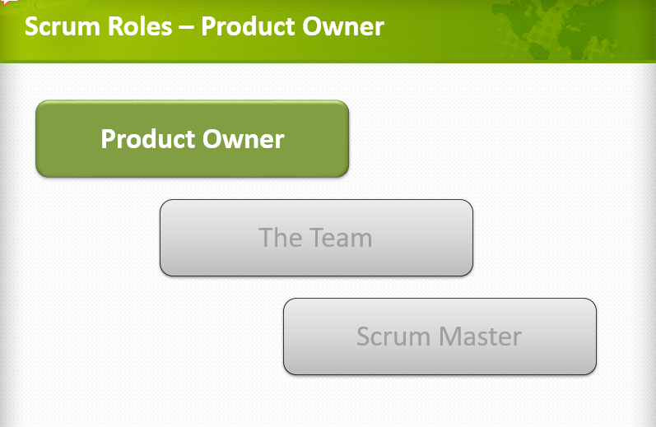

Slide 34
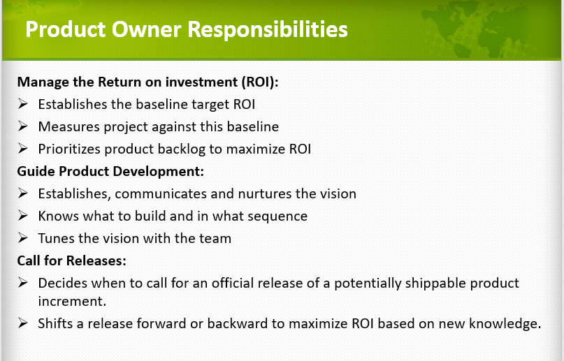

Slide 35
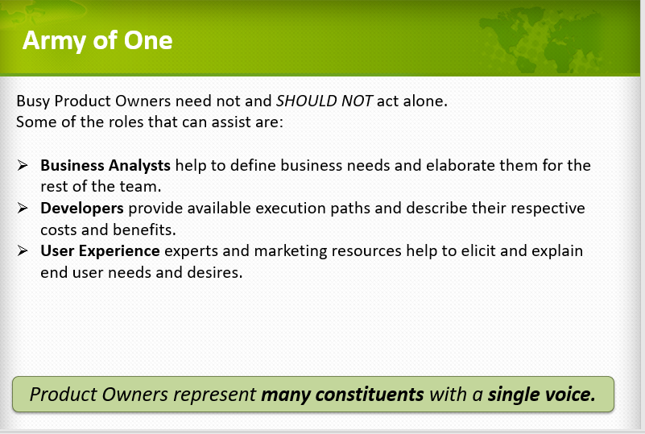

Slide 36
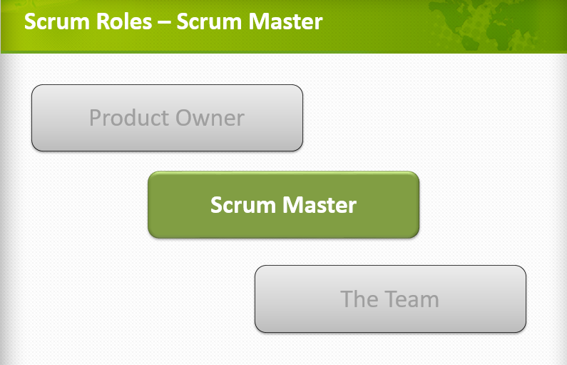

Slide 37
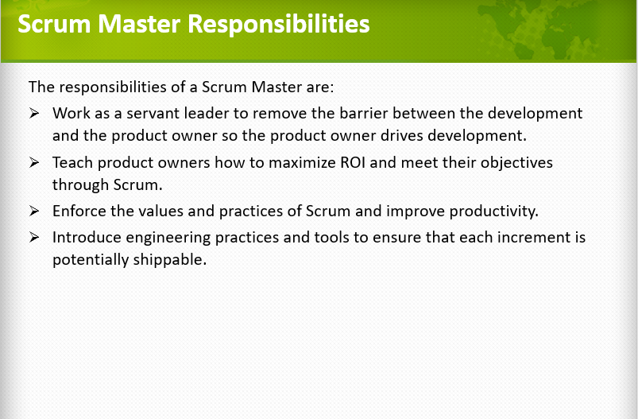

Slide 38
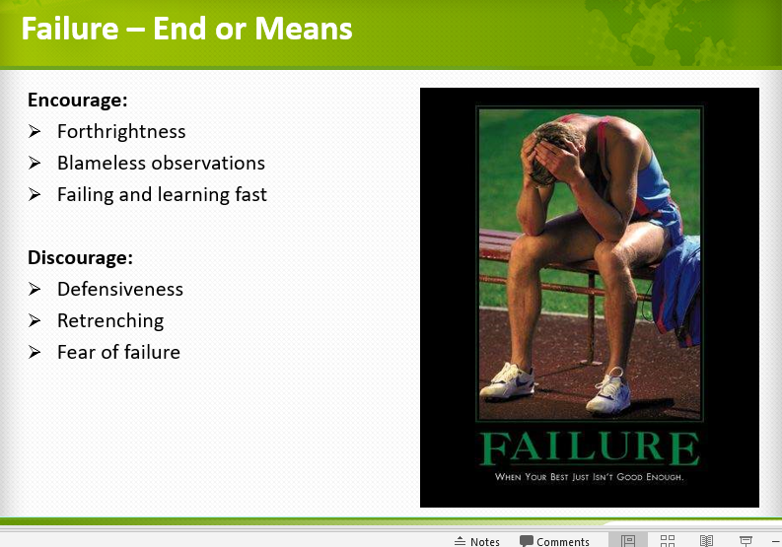

Slide 39
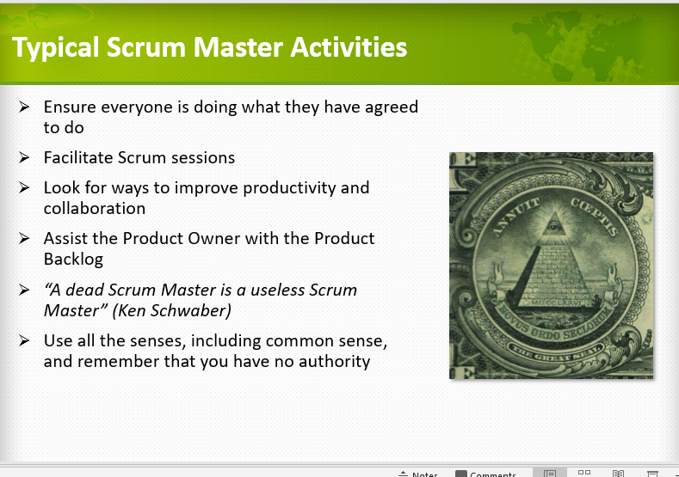

Slide 40
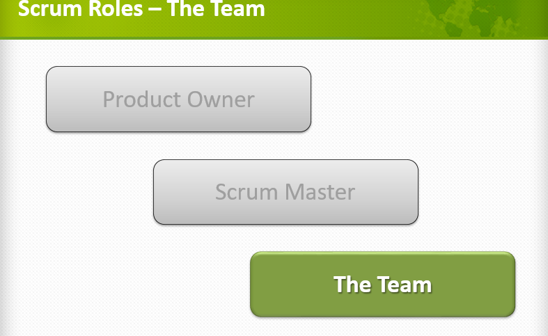

Slide 41
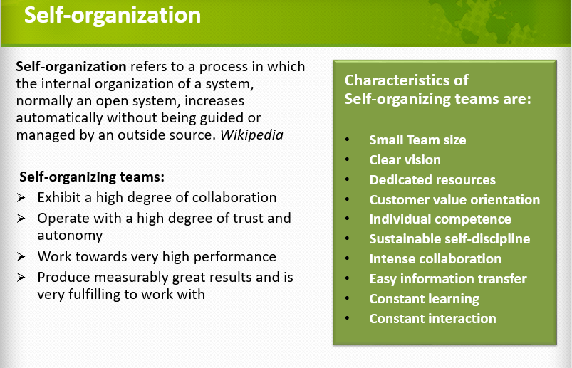

Slide 42
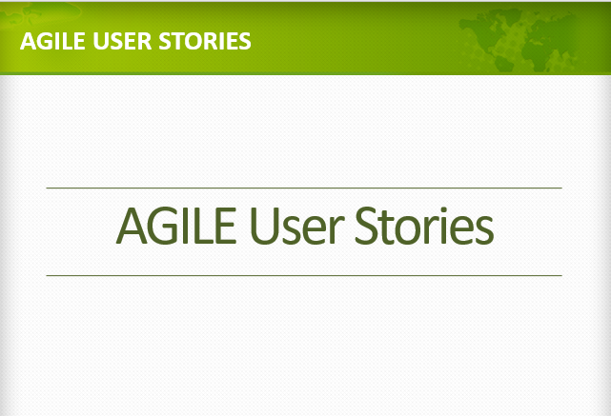

Slide 43
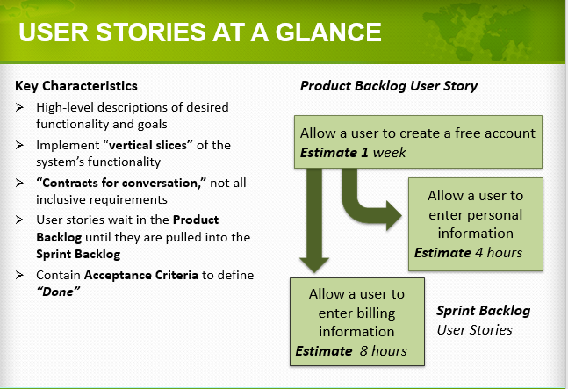

Slide 44
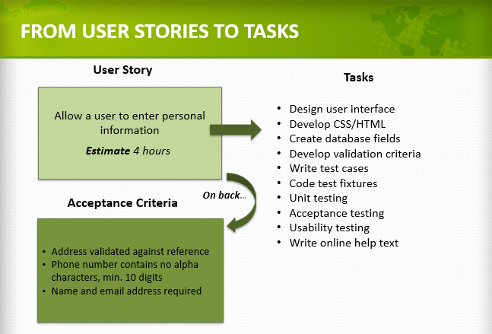

Slide 45
